Slide 1
Cost–benefit analysis
Nita Medeea-Mihaela

Slide 2

Cost–benefit analysis (CBA), sometimes called benefit costs analysis (BCA), is a systematic approach to estimating the strengths and weaknesses of alternatives used to determine options which provide the best approach to achieving benefits while preserving savings (for example, in transactions, activities, and functional business requirements). A CBA may be used to compare completed or potential courses of actions, or to estimate (or evaluate) the value against the cost of a decision, project, or policy. It is commonly used in commercial transactions, business or policy decisions (particularly public policy), and project investments.

Slide 3

Risk associated with project outcomes is usually handled with probability theory. Although it can be factored into the discount rate (to have uncertainty increasing over time), it is usually considered separately. Particular consideration is often given to agent risk aversion: preferring a situation with less uncertainty to one with greater uncertainty, even if the latter has a higher expected return.
Uncertainty in CBA parameters can be evaluated with a sensitivity analysis, which indicates how results respond to parameter changes. A more formal risk analysis may also be undertaken with the Monte Carlo method. However, even a low parameter of uncertainty does not guarantee the success of a project.

Slide 4
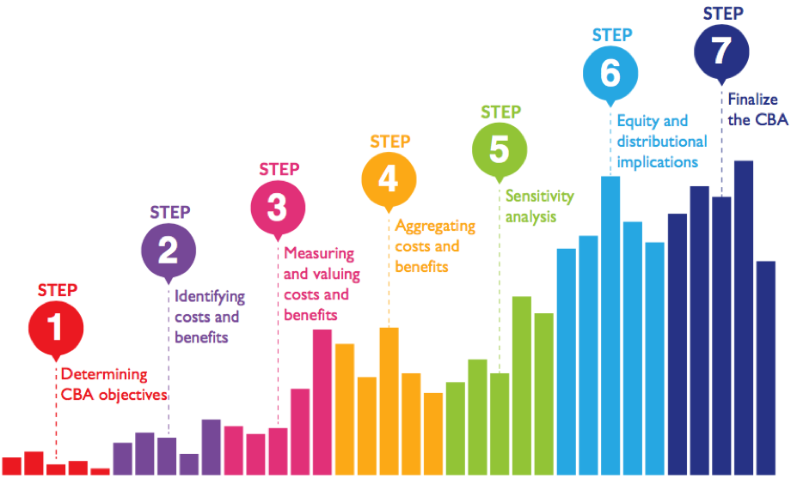
CBA has been criticized in some disciplines as it relies on the Kaldor-Hicks criterion which does not take into account distributional issues. This means, that positive net-benefits are decisive, independent of who benefits and who loses when a certain policy or project is put into place. Phaneuf and Requate phrased it as follows "CBA today relies on the Kaldor-Hicks criteria to make statements about efficiency without addressing issues of income distribution. This has allowed economists to stay silent on issues of equity, while focussing on the more familiar task of measuring costs and benefits".[

Slide 5
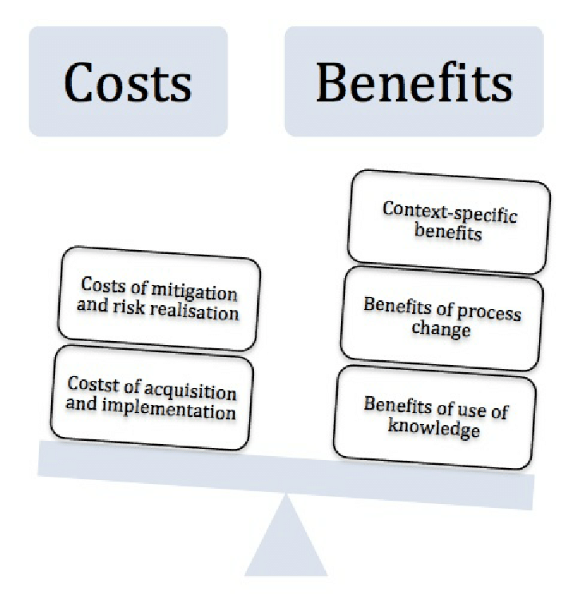
The increased use of CBA in the US regulatory process is often associated with President Ronald Reagan's administration. Although CBA in US policy-making dates back several decades, Reagan's Executive Order 12291 mandated its use in the regulatory process. After campaigning on a deregulation platform, he issued the 1981 EO authorizing the Office of Information and Regulatory Affairs (OIRA) to review agency regulations and requiring federal agencies to produce regulatory impact analyses when the estimated annual impact exceeded $100 million. During the 1980s, academic and institutional critiques of CBA emerged. The three main criticisms were:
That CBA could be used for political goals. Debates on the merits of cost and benefit comparisons can be used to sidestep political or philosophical goals, rules and regulations.
That CBA is inherently anti-regulatory, and therefore a biased tool. The monetization of policy impacts is an inappropriate tool for assessing mortality risks and distributional impacts.
That the length of time necessary to complete CBA can create significant delays, which can impede policy regulation.

Slide 6
THE END

